Slide 1
Victorian Energy Efficiency Target Scheme consultation day
Wednesday 15 June 2016

Slide 2
Proposed Activity Regulation Changes
Samantha Mikus
Policy Officer
Energy Policy and Programs

Slide 3
Consultation Timeline
15 June 2016 Consultation commences
13 July 2016 Consultation closes
1 September 2016 Proposed start date for all amended regulations
Making a submission:
Download the consultation document www.energyandresources.vic.gov.au/esi
Submissions may be emailed to energysaver.incentive@ecodev.vic.gov.au or provided in writing

Slide 4
Underfloor Insulation
Schedule 12

Slide 5
UNDERFLOOR INSULATION
SCHEDULE 12
Main changes
Reducing the required minimum R-value required for underfloor insulation from R2.5 to R1.5
Removing conductive insulation products from being an eligible VEET product
Separating the insulation of enclosed and unenclosed subfloors into two different activities.
Proposed changes to abatement factors for underfloor insulation
Current abatement factor | Proposed abatement factors
0.073 | Enclosed subfloor 0⋅05 (Schedule 12A)
 | Unenclosed subfloor 0.099 (Schedule 12B)

Slide 6
Underfloor Insulation
Schedule 12
How would the number of certificates for this activity be affected?
Certificates = Floor area in m² x Abatement Factor x Regional Factor
Example: Underfloor insulation for 160m² of uninsulated subfloor in Melbourne/Mild location
 |  | Regional factor |  | Abatement factor |  | Square metres |  | Certificates | Rounded
Current | = | 1.06 | x | 0.073 | x | 160 | = | 12.38 | 12 VEECs
Proposed Enclosed subfloor | = | 1.06 | x | 0.05 | x | 160 | = | 8.48 | 8 VEECs
Proposed Unenclosed subfloor | = | 1.06 | x | 0.099 | x | 160 | = | 16.79 | 17 VEECs

Slide 7
WEATHER SEALING
Schedule 15

Slide 8
Weather Sealing – External Doors
Schedule 15A
Main changes
Complete draught sealing of an external door
Products must be capable of lasting for at least ten years of normal use
How would the number of certificates for this activity be affected?
The proposed changes would create more certificates per installation

Slide 9
Weather Sealing – External Doors
Schedule 15A
Certificates = Abatement Factor x Regional Factor
Air sealing measure | Unit | Current Abatement factor | Proposed Abatement factor
Weather sealing external door (15A) | Per door weather sealed | 0.371 | 0.605
Location | Current Regional Factor | Proposed Regional Factor
Melbourne / Mild | 1.03 | 1.05
Regional Victoria / Mild | 0.91 | 0.84
Regional Victoria / Cold | 1.30 | 1.32
Regional Victoria / Hot | 0.84 | 0.69

Slide 10
Weather Sealing – External Window
Schedule 15B
Main changes
Permanent seal
Products must be capable of lasting for at least ten years of normal use
How would the number of certificates for this activity be affected?
The proposed changes would create a change in the number of certificates per installation

Slide 11
Weather Sealing – External Window
Schedule 15B
Certificates = Abatement Factor x Regional Factor
Air sealing measure | Unit | Current Abatement Factor | Proposed Abatement Factor
Weather sealing - external window (15B) | Per m² of window weather sealed | 0.025 | 0.027
Location | Current Regional Factor | Proposed Regional Factor
Melbourne / Mild | 1.03 | 1.05
Regional Victoria / Mild | 0.91 | 0.84
Regional Victoria / Cold | 1.30 | 1.32
Regional Victoria / Hot | 0.84 | 0.69

Slide 12
Weather Sealing – Replacing Existing Exhaust Fan with Self-Sealing Exhaust Fan
Schedule 15C
Main changes
Products must be capable of lasting for at least ten years of normal use
Product must expel air either to the outside or into the roof space of the premises
How would the number of certificates for this activity be affected?
The proposed changes would create a change in the number certificates per installation

Slide 13
Weather Sealing – Replacing Existing Exhaust Fan with Self-Sealing Exhaust Fan
Schedule 15C
Certificates = Abatement Factor x Regional Factor
Air sealing measure | Unit | Current Abatement Factor | Proposed Abatement Factor
Replacing existing exhaust fan with self-sealing exhaust fan (15C) | Per exhaust fan | 0.911 | 0.928
Location | Current Regional Factor | Proposed Regional Factor
Melbourne / Mild | 1.03 | 1.05
Regional Victoria / Mild | 0.91 | 0.84
Regional Victoria / Cold | 1.30 | 1.32
Regional Victoria / Hot | 0.84 | 0.69

Slide 14
Weather Sealing – Installing a cover with self-closing damper on existing exhaust fan
Schedule 15D
Main changes
Products must be capable of lasting for at least ten years of normal use
Installed according to manufacturer’s instructions
How would the number of certificates for this activity be affected?
The proposed changes would increase in the number certificates per installation

Slide 15
Weather Sealing – Installing a cover with self-closing damper on existing exhaust fan
Schedule 15D
Certificates = Abatement Factor x Regional Factor
Air Sealing Measure | Unit | Current Abatement Factor | Proposed Abatement Factor
Installing a cover with self-closing damper on existing exhaust fan (15D) | Per exhaust fan | 0.911 | 1.798
Location | Current Regional Factor | Proposed Regional Factor
Melbourne / Mild | 1.03 | 1.05
Regional Victoria / Mild | 0.91 | 0.84
Regional Victoria / Cold | 1.30 | 1.32
Regional Victoria / Hot | 0.84 | 0.69

Slide 16
Weather Sealing – Wall Vents
Schedule 15E
Main changes
Products must be capable of lasting for at least ten years of normal use
Products be made of a robust non-shrinking permanent sealing material
How would the number of certificates for this activity be affected?
The proposed changes would create a change in the number certificates per installation

Slide 17
Weather Sealing – Wall Vents
Schedule 15E
Certificates = Abatement Factor x Regional Factor
Air Sealing Measure | Unit | Current Abatement Factor | Proposed Abatement Factor
Sealing wall vents (15E) | Per wall vent | 0.231 | 0.236
Location | Current Regional Factor | Proposed Regional Factor
Melbourne / Mild | 1.03 | 1.05
Regional Victoria / Mild | 0.91 | 0.84
Regional Victoria / Cold | 1.30 | 1.32
Regional Victoria / Hot | 0.84 | 0.69

Slide 18
Weather Sealing – Installing chimney damper to open fireplace – permanent and temporary
Schedule 15F and proposed new Schedule 15G
Main changes
15F for permanent chimney installations (10 year lifetime)
15G for chimney installations that are temporary or seasonal (5 year lifetime)
15G be accompanied with appropriate signage when installed that indicates that a product has been installed in the chimney or flue as well as with instructions for removal
How would the number of certificates for this activity be affected?
Certificates for this activity would be more accurately calculated based on the lifetime of the product (i.e. either five or ten years).

Slide 19
Weather Sealing – Installing chimney damper to open fireplace – permanent and temporary
Schedule 15F and proposed new Schedule 15G
Certificates = Abatement Factor x Regional Factor
Air Sealing Measure | Unit | Current Abatement Factor | Proposed Abatement Factor 15F | Proposed Abatement Factor 15G
Installing chimney damper to open fireplace (15F) | Per chimney damper | 5.130 | 5.234 | 2.617
Location | Current Regional Factor | Proposed Regional Factor
Melbourne / Mild | 1.03 | 1.05
Regional Victoria / Mild | 0.91 | 0.84
Regional Victoria / Cold | 1.30 | 1.32
Regional Victoria / Hot | 0.84 | 0.69

Slide 20
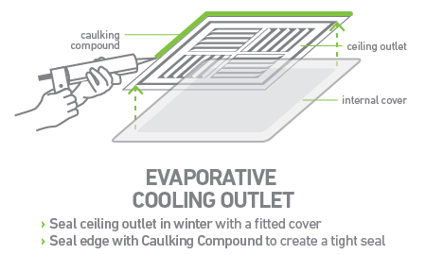
Weather sealing – Ducted evaporative cooling covers
Proposed new schedule 15H

Slide 21
Weather sealing – Ducted evaporative cooling covers
Proposed new schedule 15H
Certificates = Abatement Factor x Regional Factor
Air Sealing Measure | Unit | Proposed Abatement Factor
Ducted evaporative cooling covers (15H) | Per cover | 0.238
Location | Proposed Regional Factor
Melbourne / Mild | 1.05
Regional Victoria / Mild | 0.84
Regional Victoria / Cold | 1.32
Regional Victoria / Hot | 0.69

Slide 22
High Efficiency Televisions
Schedule 24

Slide 23
High Efficiency Televisions
Schedule 24
Main changes
minimum eligibility criteria used for televisions in VEET proposed to change to reflect improvements in TV efficiency since 2010
Current Eligibility | Proposed Eligibility
Minimum 5.5 Stars | Minimum 7 Stars
Comparative Energy Consumption on the Energy Rating Label of not more than 450 kWh/year | Comparative Energy Consumption on the Energy Rating Label of not more than 300 kWh/year

Slide 24
Next steps
How to provide your comments
This document is intended to be read alongside the draft Regulations which can be accessed online at www.energyandresources.vic.gov.au/esi.
Responses should clearly state the issue and, where relevant, make reference to specific sections of the draft Regulation.
Submitting by email
Submissions may be emailed to energysaver.incentive@ecodev.vic.gov.au.
Please use the subject: VEET: Proposed Activity Regulation Changes June 2016

Slide 25
New Project Based Activity Method:
Treatment and Control
Emma Jacobs
Senior Policy Officer
Energy Policy and Programs

Slide 26
Treatment & Control method
Providing energy savings goods or services to a large group of sites
Energy savings are calculated by comparing the energy consumption of these sites to the energy consumption of a group which did not receive the goods or services
Using a statistical test to determine if energy savings have occurred

Slide 27
Treatment & Control method
The treatment is the provision of energy efficiency goods or services
For example:
  Household energy audits
  Letters or reports about energy consumption
  Energy saving advice
  Discounts or vouchers for the purchase of new energy efficient equipment

Slide 28
Treatment & Control method
The group which does not receive the treatment is called the control group
The treatment group and the control group are both randomly selected from a larger group of similar sites (called a population)
An example of a population might be the residential customers of a specific energy retailer living in a certain area

Slide 29
Three sub-methods
Sub-method 1: comparison between the daily household energy consumption of the treatment and that of the control group
Sub-method 2: comparison between the change in daily household energy consumption of the treatment and that of the control group
Sub-method 3: regression analysis to separate the effect of the treatment from other changes in energy consumption

Slide 30
Prescribed Greenhouse gas schemes
Under the VEET Regulations certain schemes are listed as prescribed greenhouse gas schemes
Certificates can be claimed under the VEET or the prescribed greenhouse gas scheme – but not both
The Commonwealth Emissions Reduction Fund is currently listed as a prescribed greenhouse gas scheme

Slide 31
Renewable energy Target
The amendment proposes to add the Commonwealth Renewable Energy Target to list this of prescribed greenhouse gas schemes
Solar water heaters currently claim both VEECs and incentives under the RET and would be exempt from this requirement

Slide 32
Product requirements
It is proposed that product requirements are limited to those required for consistency with other VEET scheme activities:
  If the treatment uses new products of a type covered by another VEET schedule, they must be on the ESC Product Register
  If a product is required to be decommissioned under another VEET schedule, they must be decommissioned under this method

Slide 33
Project plan
Accredited Persons would be required to submit a project plan before the treatment starts
The proposed requirements include:
  A description of the treatment activities
  The sub-method used
  Whether the project uses electricity, natural gas or both
  A list of the addresses in the Treatment and Control groups
  A risk management plan
  Written confirmation from a statistician that the Treatment and Control groups were selected in an unbiased manner

Slide 34
Accredited statistician
Accredited statistician means a person accredited as a statistician by the Statistical Society of Australia
The method requires that an accredited statistician sign off on:
  The allocation of sites to the treatment and control groups
  Any variations which add new sites
The ESC may also require a statistician to assess the calculations prior to approval

Slide 35
Included sites

Slide 36
Included sites
Once sites are included in a control or treatment group, they must be included in the calculations
The method specifies the circumstances when a site can be removed from the project
  For example, if a site changes energy retailers and the project proponent loses access to their data
This is referred to in the method as the site being ‘affected by attrition’

Slide 37
Affected by Attrition
A site may be removed when it is affected by attrition, which is when:
  the energy account for the site is terminated; or
  the occupant of the site withdraws their permission for their data to be used; or
  the meter at the site fails and is not repaired in a timely manner.

Slide 38
The t-Test

Slide 39
The t-Test
The t-test is a very common statistical test used to determine if variation between two groups is random or not
The three sub-methods each have a different equation to calculate the t-value
In order to be eligible for VEECs the method requires that there is a 95% probability that the variation between the treatment and control groups is not due to random chance

Slide 40
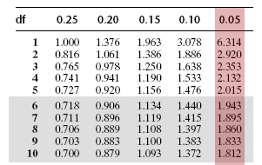
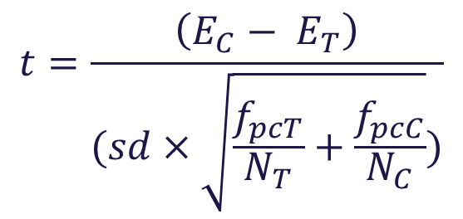
The t-Test
If the treatment worked the energy consumption for the control group will be larger then the treatment group:
E_{C} ≤ E_{T}
Reject null hypothesis if: t > T(0.95)
T-table
$$t=\frac{\left(E_{C}− E_{T}\right)}{(sd×\sqrt{\frac{f_{pcT}}{N_{T}}+\frac{f_{pcC}}{N_{C}}})}$$

Slide 41
Passing the T-Test
The larger and more similar a population is, the easier it is to pass the t-test
Populations which have highly variable energy consumption will need to be very large to have a reasonable expectation of passing the t-test
Treatments which have a very small effect on energy consumption will also require a larger population

Slide 42
Passing the T-test
Below is an example of the required population size for a treatment and control type project in California.
Effect of treatment on energy consumption (%) | Required size of population
10% | 108
5% | 430
2.5% | 1,716
2% | 2,680
1.5% | 4,762
1% | 10,714
0.5% | 42,856
Source: Brattle Group (2011), see: http://www.brattle.com/system/news/pdfs/000/000/214/original/Measurement_and_Verification_Principles_for_Behavior-Based_Efficiency_Programs_Sergici_Faruqui_May_2011.pdf?1377791292

Slide 43
Uplift

Slide 44
What is uplift?
The method does not allow the treatment to directly promote other VEET activities
Promoting energy efficiency to the treatment group may result in an increased take up of other VEET activities
The AP does not have control over the activities which occur at the site

Slide 45
What is Uplift?
Uplift can result in double counting with:
  Other VEET schedules
  Commonwealth Emissions Reduction Fund
  Commonwealth Renewable Energy Target
The ESC has the power to calculate ‘uplift’ for a particular Treatment and Control project
The uplift amount is deducted from the number of VEECs the project receives

Slide 46
What is Uplift?
Certificates awarded under T&C project
For example, a treatment could involve providing an app which displays current energy use
Users of the app would become aware of the amount of energy used by their halogen downlights
As a result the sites in the treatment group would be more likely to undertake a schedule 21C lighting upgrade
Treatment group undertakes additional deemed VEET activities
Average rate of deemed activities

Slide 47
Next Steps

Slide 48
Regulation amendment timeline
15 June 2016 | Consultation starts
13 July 2016 | Consultation closes, last date for submissions
1 October 2016 | Proposed start date for Treatment and Control method
TBC | ESC publishes guidelines and explanatory notes for method and begins accepting certificate creations

Slide 49
Making a Submission
Download the consultation document: www.energyandresources.vic.gov.au/esi
Submissions may be emailed to energysaver.incentive@ecodev.vic.gov.au or provided in writing
Submissions for regulation amendments close on 13 July 2016
Please use the subject: VEET: Treatment and Control

Slide 50
Questions?

Slide 51
New Project Based Activity Method:
Measurement and Verification
Kathryn Lucas-Healey
Senior Policy Officer
Energy Policy and Programs

Slide 52
2015 Consultation on Project Based Activities
Last year, we asked for your input on project based activities in the VEET scheme
You said:
Use robust, industry-standard principles
Make it flexible and technology neutral
Balance rigour with incentives
Support the development of industry
Align with NSW

Slide 53
Measurement and Verification (M&V) Method
The proposed Measurement and Verification (M&V) method is a flexible method for large, unique or complex upgrades
Technology neutral
Industry standard approach to quantifying savings
You choose how to balance accuracy and incentives
Based on revised NSW method Project Impact Assessment with Measurement and Verification (PIAM&V)

Slide 54
M&V method
Eligible upgrades
The M&V method is designed to be technology neutral – it will credit any upgrade that results in greenhouse gas savings from electricity or gas consumption, except:
Upgrades required by legislation
Projects that have already occurred
New projects
Projects that claim Renewable Energy Certificates*
Projects across multiple locations*

Slide 55
M&V method
How it works
The baseline is the energy that would have been used if the upgrade had never happened – it’s not as simple as looking at old records
You need to create a baseline energy model
After the upgrade, you need to know either how much energy is used, or be able to predict how much energy will be used
You might also need an operating energy model
Savings | = | Baseline energy consumption | - | Energy consumption after the upgrade

Slide 56
M&V method
Product requirements
It is proposed that product requirements are limited to those required for direct consistency with other VEET activities:
If the upgrade uses new products of a type covered by another VEET schedule, they must be on the ESC Product Register
If a product is required to be decommissioned under another VEET schedule, they must be decommissioned

Slide 57
M&V method
Project plan
The first point of contact between the Accredited Person (AP) and the ESC
The purpose of the project plan is to:
Register the project with the ESC before it is installed
Define the project:
  The address
  The purpose and which services will be affected
  Consent from the energy consumer
  Risk management plan

Slide 58
M&V method
Public register of submitted project plans
The project plan is also the first opportunity to identify potential double-counting from multiple projects on the same site
One option to help APs manage multiple projects is to have a public register:
Site address
Name of AP
Method being used (e.g. Schedule 37 M&V Method)
Should there be a public register of submitted project plans?
What information should be on it?

Slide 59
M&V method
Project plan variation
The project plan may be varied before certificates are created
The address, purpose and affected services must not change
The risk management plan must be updated

Slide 60
M&V method
Baseline model
The baseline is the energy that would have been used if the upgrade had never happened
Based on data collected before the upgrade
The baseline energy model could be:
A regression model that relates energy consumption with one or more independent variables
An average model where there isn’t much variation

Slide 61
M&V method
Implementation
When the project is carried out – when all changes have been implemented and normal operations are capable of commencing
Project can include:
Installing or removing an energy consuming product
Changing the way an existing energy consuming product is used
Installing or removing a product that affects the energy consumption of another product

Slide 62
M&V method
Operating and reporting periods
Now the project has been implemented, it’s time to take more measurements
Projects using forward creation of certificates need to create an operating energy model
  The operating energy model is used to predict how much energy will be used over the lifetime of the upgrade
Project using annual creation of certificates only need to measure the energy consumption for each annual reporting period

Slide 63
M&V method
Calculating savings – forward creation
The operating energy model calculates energy use in a normal year:
E.g. a typical year of weather, or an average year of production
The savings are adjusted for:
Accuracy factor – more accurate models give more savings
Decay factor – estimate of how well the project performs over time
Savings | = | Baseline consumption in a normal year | - | Operating consumption in a normal year

Slide 64
M&V method
Calculating savings – annual creation
Annual creation requires measurement of the energy consumption and the independent variables for a whole year
Compare the energy consumption with the baseline case
Adjust with the accuracy factor for the baseline model
Savings | = | Baseline consumption in year i | - | Measured consumption in year i

Slide 65
M&V method
Calculating savings – interactive energy savings
What if there are other energy savings that haven’t been accounted for?
E.g. lower air conditioning load due to lighting upgrade
Use engineering calculations to estimate the interactive energy savings
Can be up to 10% of the savings calculated in the previous slides

Slide 66
M&V method
Accounting for all savings
You can:
Subtract certificates from other VEET activities, if they overlap
Forward create certificates more than once
Combine forward creation and annual creation

Slide 67
M&V method
Alignment with the NSW method
What are the differences?
Baseline after implementation allowed in some cases
Any ‘behind the meter’ savings, including generation
Multi-site sampling and simulated baselines to be considered for later inclusion
Interactive energy savings limited to 10%
Must report negative savings in order to continue annual creation

Slide 68
Next Steps

Slide 69
Regulation amendment timeline
15 June 2016 | Consultation starts
13 July 2016 | Consultation closes, last date for submissions
1 October 2016 | Proposed start date for Measurement and Verification method
TBC | ESC publishes guidelines and explanatory notes for method and begins accepting certificate creations

Slide 70
Making a Submission
Download the consultation document: www.energyandresources.vic.gov.au/esi
Submissions may be emailed to energysaver.incentive@ecodev.vic.gov.au or provided in writing
Submissions for regulation amendments close on 13 July 2016
Please use the subject: VEET: Measurement and Verification

Slide 71
New Project Based Activity Method:
Benchmark Rating
Emma Jacobs
Senior Policy Officer
Energy Policy and Programs

Slide 72
The benchmark rating method
Uses NABERS ratings to calculate energy savings for buildings
Benchmark rating means a comparison of a buildings energy performance with other buildings of the same type
Energy savings are calculated by comparing a baseline rating taken from before energy efficiency works to an annual rating each year after works are completed

Slide 73
The benchmark rating method
Savings | = | Baseline energy | - | Reporting energy
Reporting Energy is taken from the rating report for the year energy savings are being calculated
Baseline Energy is the calculation of what the energy consumption would have been at the building without the project.

Slide 74
The benchmark rating method
Based on the NSW Energy Saving Scheme NABERS method
Similar to the Commonwealth Emissions Reduction Fund Commercial Buildings method
Method only covers existing buildings

Slide 75
The benchmark rating method
NABERS is not referred to directly in the method for legal drafting reasons
The draft amendment to the VEET Regulations refers to ‘benchmark rating schemes’ approved by the ESC

Slide 76
Approved Benchmark rating schemes
The ESC can approve benchmark rating schemes that meet certain requirements, including:
  The rating is based on measured energy usage (not simulations)
  The scheme has a published methodology for all inputs
  The scheme has a reverse calculator
  Ratings are subject to independent audit

Slide 77
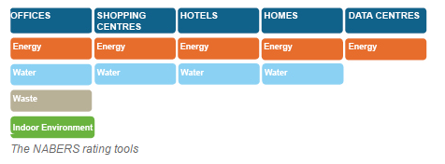
About NABERS
National Australian Built Environment Rating Scheme (NABERS) Energy
NABERS has ratings for multiple building types

Slide 78
NABERS rating types
NABERS has ratings for office buildings, shopping centres, hotels and data centres
Some building types are divided into three ratings to allow separate ratings for:
  building services controlled by tenants (for example computers)
  building services controlled by building operators (for example HVAC systems)
Office Buildings | Data centres
Tenancy rating | IT Equipment rating
Base building rating | Infrastructure rating
Whole building rating | Whole facility rating

Slide 79
Benchmark rating method

Slide 80
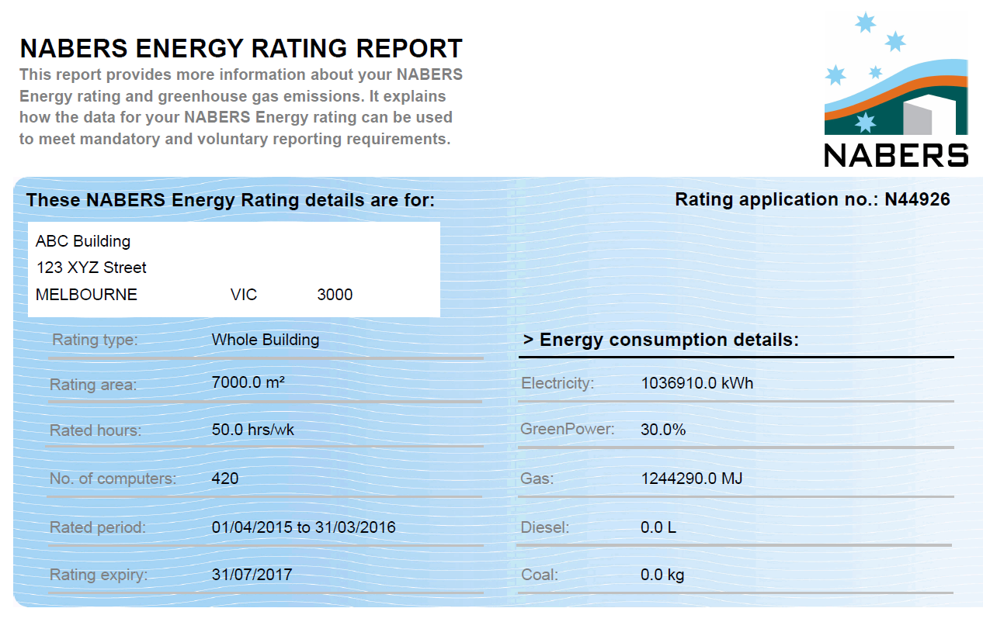
NABERS rating Report
Building location
Variables
Rating period

Slide 81
Variables
Each rating uses variables to normalise energy consumption for that building type
A five star building with 600 computers uses more energy than a five star building with only 400 computers
These variables may change over time
This is accounted for in the VEET Regulations using the reverse calculator to determine what the energy consumption for the building would be with the current variables.

Slide 82
NABERS rating Report
Energy consumption

Slide 83
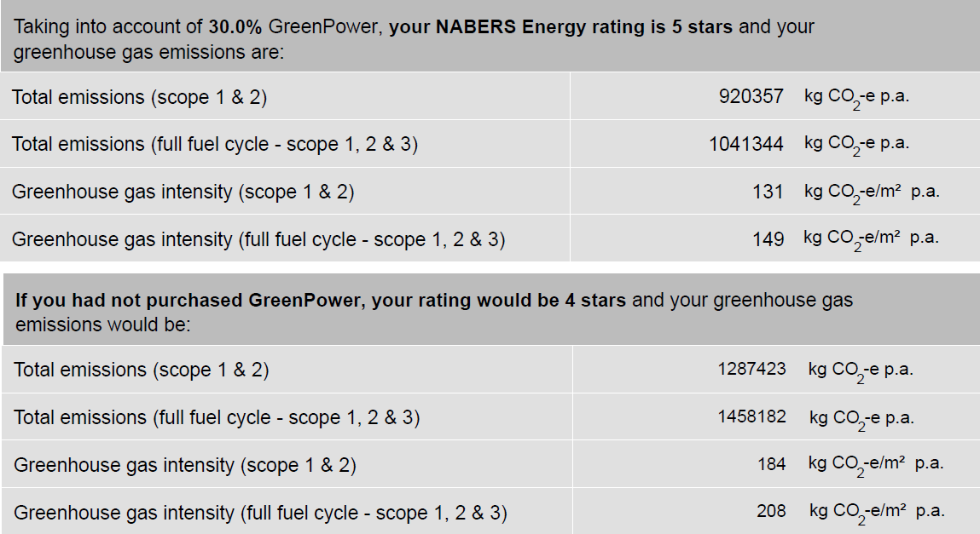
Nabers Rating Report

Slide 84
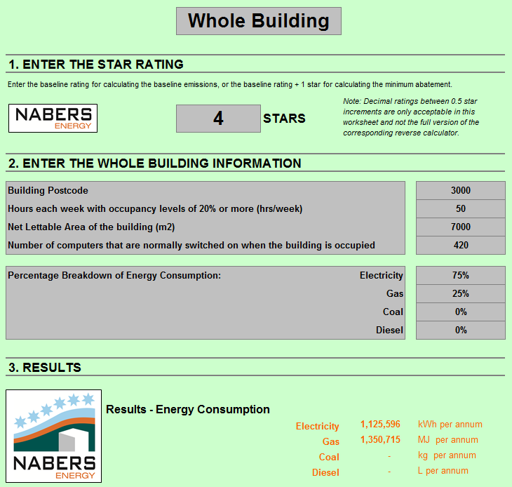

Slide 85
Baseline rating

Slide 86
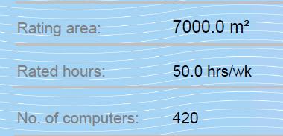
Variables

Slide 87
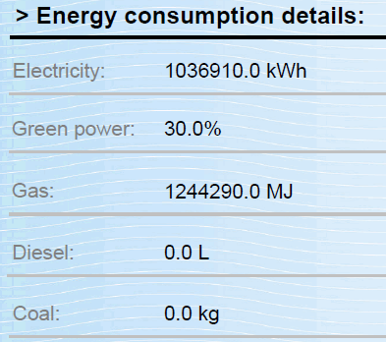
Percentage energy consumption

Slide 88
Baseline energy consumption

Slide 89
Business as usual improvement
The method credits all improvements in energy efficiency which occur in the building
This includes activities which are not part of the project
A factor is included in the method which assumes all buildings improve in energy efficiency by 3% per year

Slide 90
On site electricity generation
NABERS ratings only accounts for energy imported into the building
On-site renewable energy systems reduce the amount of electricity imported into the building

Slide 91
On site electricity generation
Substituting electricity or gas with renewable energy is allowed
The Renewable Energy Target is listed as a prescribed greenhouse gas scheme, with the exception of solar water heaters
Participants can received credit under the Renewable Energy Target or the VEET but not both

Slide 92
Changes to Metering
Each NABERS rating has a boundary for part of the building which is being rated – for example an office building with a café on the ground floor may exclude the café
This boundary may change if the metering arrangements at the site are changed
The method includes requirements to account for changes in metering at the building

Slide 93
Where renovations trigger section J
Renovations or upgrades may trigger the building code and require certain energy efficiency activities
The baseline is altered to account for these activities
The baseline rating for each reporting period commencing after the renovation or upgrade is completed is the highest of:
  the rating for the baseline period,
  the rating required under the planning scheme,
  a default rating:
    5 stars for a building that is a data centre or
    4 stars for any other building

Slide 94
Project plan
Accredited Persons would be required to submit a project plan before the treatment starts
The proposed requirements include:
  A description of the project activities
  Details of the baseline benchmark rating
  A risk management plan

Slide 95
Regulation amendment timeline
15 June 2016 | Consultation starts
13 July 2016 | Consultation closes, last date for submissions
1 October 2016 | Proposed start date for Benchmark method
TBC | ESC publishes guidelines and explanatory notes for method and begins accepting certificate creations

Slide 96
Making a Submission
Download the consultation document: www.energyandresources.vic.gov.au/esi
Submissions may be emailed to energysaver.incentive@ecodev.vic.gov.au or provided in writing
Submissions for regulation amendments close on 13 July 2016
Please use the subject: VEET: Benchmark rating method

Slide 97
Questions?

Slide 98
Options for Including Large Energy Users
Tejopala Rawls
Senior Policy Officer
Energy Policy and Programs

Slide 99
Options for including large energy users
What is the current situation?
Why have large energy users been excluded until now?
Why include large energy users?
What options are being proposed?
How to make a submission

Slide 100
What is the current situation?
Certain large energy users are excluded from VEET
These organisations are excluded under the VEET scheme’s regulations from:
Generating certificates
Creating a liability for energy retailers

Slide 101
What is the current situation?
Certain large energy users are excluded from VEET
These are large energy users that once participated in the Environment Protection Authority’s Environment and Resource Efficiency Plans (EREP) program

Slide 102
Why have large energy users been excluded from veet until now?
Avoiding duplication
This exclusion came about because EREP already created a mandatory requirement for energy efficiency upgrades
Including large energy users in VEET would have created duplication

Slide 103
Why include large energy users?
The policy context has changed
The EREP program closed in 2013
There is no longer any duplication

Slide 104
Why include large energy users?
More opportunities and access to benefits
The incentives provided by the scheme would make energy efficiency improvements more economically viable for large energy users

Slide 105
Why include large energy users?
More opportunities and access to benefits
Including large energy users in the VEET scheme would also increase the pool of energy efficiency opportunities available to generate certificates

Slide 106
Why include large energy users?
Interest from stakeholders
A number of large energy users expressed an interest in being able to participate in the VEET scheme when the Department consulted on this issue in 2015

Slide 107
Why include large energy users?
New methods make inclusion possible
The kind of upgrades that large energy users are likely to undertake may need a customised approach to determining energy savings
For this reason three new measurement methods are being proposed, known as Project Based Activities (PBAs)

Slide 108
Why include large energy users?
Reduced administrative burden
Some energy retailers have noted the administrative burden of identifying large energy users and removing their energy consumption from their annual Energy Acquisition Statements
This is made more complex now that the EREP program has closed

Slide 109
What are the options being proposed?
An immediate option and a gradual option
The immediate option would end the exclusion from January 1 2017
The gradual option would create an initial voluntary period until January 1 2020

Slide 110
Immediate option
Ending the exclusion from January 1 2017
All large energy users, including those on the current EREP register, could gain VEET incentives from January 1 2017
The exclusion from creating liabilities for energy retailers would also end from January 1 2017

Slide 111
Gradual option
An initial voluntary period
The exclusion for generating certificates would end on January 1 2017
Liabilities for energy retailers would start on the sooner of:
  January 1 of the calendar year after a
  large energy user created its first certificate
  January 1 2020

Slide 112
Gradual option
A new list of excluded organisations
A new list of excluded large energy users would be included in the VEET Regulations
This would be based on those large energy users for which energy retailers are currently claiming an exemption for liability

Slide 113
Gradual option
Why not use the EITE list?
Another list of large organisations is the Energy Intensive Trade Exposed (EITE) list held by the Commonwealth Clean Energy Regulator for the purposes of the Renewable Energy Target (RET)
The basis for being listed on this register is not energy use but greenhouse gas emissions, which in many cases come from sources not related to energy use
This list is therefore not suitable as the basis on which the energy use of large energy users might continue to be excluded

Slide 114
Immediate option
Advantages
More immediate and simple
The benefits of including large energy users in the scheme would take effect straight away.
It would also remove administrative and compliance burden from energy retailers.

Slide 115
Gradual option
Advantages
Interested large energy users could participate
in the VEET scheme while allowing a transition period for others
Large energy users would have time to plan and schedule energy efficiency upgrades
A large energy user would only create liability in the scheme once it had generated its first certificate

Slide 116
Gradual option
Disadvantages
Extending for another three years the administrative and compliance burden on energy retailers

Slide 117
Making a Submission
Download the consultation document: www.energyandresources.vic.gov.au/esi
Submissions may be emailed to energysaver.incentive@ecodev.vic.gov.au or provided in writing
Submissions for regulation amendments close on 13 July 2016
Please use the subject: VEET: Options for including large energy users

Slide 118
Compliance process for greenhouse gas reduction rates
Tejopala Rawls
Senior Policy Officer
Energy Policy and Programs

Slide 119
Compliance process for Greenhouse Gas Reduction Rates
What is the current situation?
What is the problem?
Proposed changes
Why make these changes?
How to make a submission

Slide 120
What is the current situation?
Greenhouse Gas Reduction Rates are set in May
The liabilities faced by energy retailers under the VEET scheme are calculated each year using figures known as the Greenhouse Gas Reduction Rates
There are two such Rates: one for gas and one for electricity

Slide 121
What is the current situation?
Greenhouse Gas Reduction Rates are set in May
The Rates are published in the Government Gazette in May of the year to which they apply
The data used to estimate these Rates are the scheme acquisitions shown in the Energy Acquisition Statements submitted by energy retailers by the end of April each year

Slide 122
What is the problem?
The timing creates uncertainty
As a result of this timing energy retailers do not know their liabilities for the first four months of each year and therefore have to estimate these during that time
This uncertainty may raise the cost of the scheme which could ultimately be passed onto consumers

Slide 123
What is being proposed?
Changing the publication date to the year before
The date on which Rates are published would be changed to Quarter 4 of the year prior to the liability year for which they apply
This could be effective from the 2017 liability year, for which the Rates would be published by Quarter 4 of 2016

Slide 124
What is being proposed?
Using data from two years before the liability year
The data used to calculate the Rates would be changed to the most recent available
This would be for the year two years prior to the liability year
For example, for the 2018 compliance year, the Rates would be set by Quarter 4 of 2017 using energy retailers’ Energy Acquisition Statements for 2016

Slide 125
Why make these changes?
Greater certainty about scheme liabilities
Bringing forward the date on which the Rates are published would create greater certainty for energy retailers as to their scheme liabilities

Slide 126
Further Details
Limited options for data sources
The data used to calculate the Rates are not available until April 30 each year
Therefore it is proposed data from a year earlier is the best available

Slide 127
Further Details
Implications of using older data
Modelling indicates that the number of certificates would be within the range of variation normally seen year to year
When setting the Rates, any shortfall or excess in the number of certificates from the year before is normally taken into consideration to ensure that the target is met

Slide 128
Further Details
Regulatory implications
The proposed changes would not involve any changes to the VEET Act or Regulations and would involve only administrative changes

Slide 129
Making a Submission
Download the consultation document: www.energyandresources.vic.gov.au/esi
Submissions may be emailed to energysaver.incentive@ecodev.vic.gov.au or provided in writing
Submissions close on 13 July 2016
Please use the subject: VEET: Greenhouse Gas Reduction Rates

