Slide 1
Hume Hydrogen Highway initiative
Developing a hydrogen refuelling network along the Hume Highway
Date: 27 July 2022
Office of Energy and Climate Change within NSW Treasury (OECC)
Victorian Department of Environment, Land, Water and Planning (DELWP)

Slide 2
Acknowledgement of Country
The Office of Energy and Climate Change within NSW Treasury and the Victorian Department of Environment, Land, Water and Planning acknowledge that Aboriginal and Torres Strait Islander peoples are the First Peoples and Traditional Custodians of Australia, ​and the oldest continuing culture in human history. ​
We pay respect to Elders past and present and commit to respecting the lands we walk on, and the communities we walk with. ​
We celebrate the deep and enduring connection of Aboriginal and Torres Strait Islander peoples to Country ​and acknowledge their continuing custodianship of the land, seas ​and sky.​
We acknowledge the ongoing stewardship of Aboriginal and Torres Strait Islander peoples, and the important contribution they make to our communities and economies. ​
We reflect on the continuing impact of government policies and practices, ​and recognise our responsibility to work together with and for Aboriginal and Torres Strait Islander peoples, families and communities, towards improved economic, social and cultural outcomes.
OFFICIAL-Sensitive

Slide 3
Agenda
Introduction - Policy support for hydrogen
Hume Hydrogen Highway initiative overview
Who can apply?
What will be funded?
The application and assessment process
Assessment criteria
How to apply?
Presentations from ARENA and CEFC
Q&A session

Slide 4
Probity Briefing
Elmira Karami, RSM, Probity advisor
NSW Office of Energy and Climate Change within NSW Treasury (OECC)
Victorian Department of Environment, Land, Water and Planning (DELWP)
OFFICIAL-Sensitive

Slide 5
Probity Briefing
RSM is the independent, external Probity Advisor engaged by the States
As Probity Advisor we are not members of the Evaluation Panel
Our role is to ensure generally accepted probity principles are applied:
Use of a competitive process
Identification and resolution of conflicts of interest
Security and confidentiality
Transparency and consistency of process

Slide 6
Probity Briefing
Please do not communicate with personnel of or advisors to the States other than by way of the mechanism provided
Failure to comply with this requirement may lead to disqualification from the process
Be aware of closing dates and times, both for Questions and Answers and particularly the submission closing date and time
Do not assume you will have the opportunity to expand or clarify your submission, ensure your submission is as complete as possible

Slide 7
Policy support for hydrogen
Tim Stock, Director Hydrogen and Clean Energy, OECC
Kim Le Cerf, Director Energy Programs, DELWP
NSW Office of Energy and Climate Change within NSW Treasury (OECC)
Victorian Department of Environment, Land, Water and Planning (DELWP)
OFFICIAL-Sensitive

Slide 8
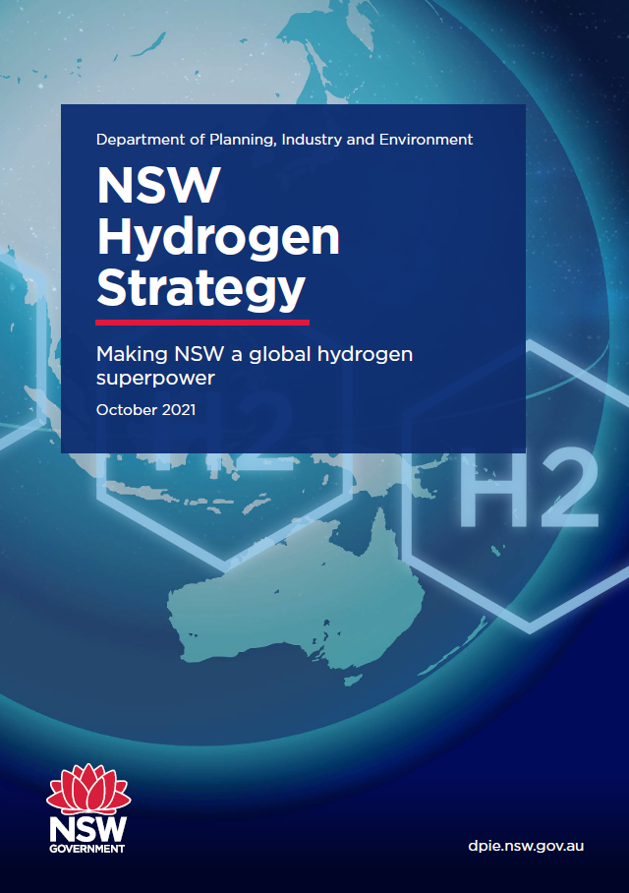
NSW Hydrogen Strategy
$3B Incentives
<$2.80/kg
LCOH
60 Actions

Slide 9
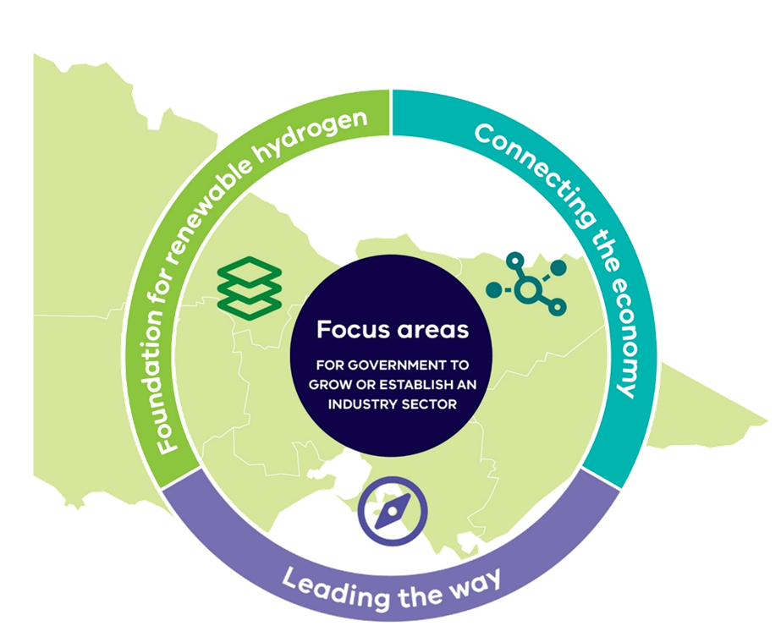
Victorian Renewable Hydrogen Industry Development Plan

Slide 10
The Hume Hydrogen Highway initiative
Ting Yuan, Senior Program Manager Technology Development, DELWP
NSW Office of Energy and Climate Change within NSW Treasury (OECC)
Victorian Department of Environment, Land, Water and Planning (DELWP)
OFFICIAL-Sensitive

Slide 11
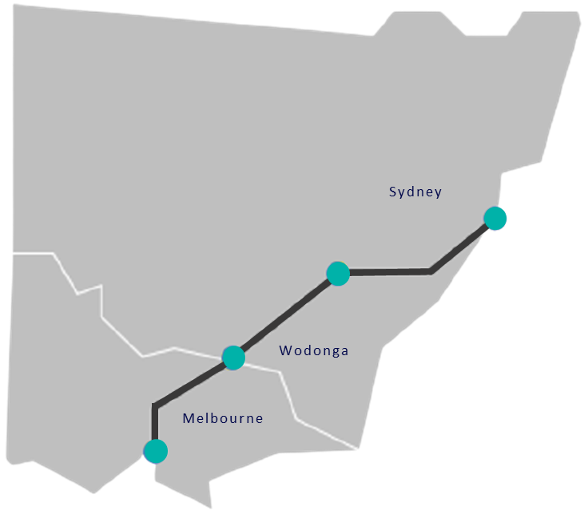
Initiative overview
NSW and Victorian Government Memorandum of Understanding to co-fund and co-deliver a grants program supporting the deployment of a hydrogen refuelling network along the Hume Highway
$20 million competitive grant initiative, co-funded by the NSW and Victorian State Governments, to support:
At least 4 hydrogen refuelling stations, between Melbourne and Sydney
At least 25 hydrogen-powered trucks
Kick-starting the decarbonisation of the heavy transport industry across NSW and Victoria
Note: this corridor layout is provided for illustration purposes only. It does not reflect mandatory station locations.

Slide 12
Initiative objectives
Accelerate the development of a renewable hydrogen economy in NSW and Victoria
Promote the decarbonisation of the transport sector, supporting the reduction of greenhouse gas emissions in both NSW and Victoria
Promote the heavy transport sector as a key offtake for renewable hydrogen
Build the foundational local knowledge, skills, infrastructure and supply chains that will drive large scale market activation and widespread commercial uptake of renewable hydrogen in the heavy transport sector
Leverage at least matched funding to create new jobs and capital investment in NSW and Victoria
Generate and share knowledge that demonstrates a repeatable and scalable commercial model for hydrogen refuelling
1
2
3
4
5
6

Slide 13
Who can apply?
Tim McMinn, Manager Hydrogen Programs, OECC
NSW Office of Energy and Climate Change within NSW Treasury (OECC)
Victorian Department of Environment, Land, Water and Planning (DELWP)
OFFICIAL-Sensitive

Slide 14
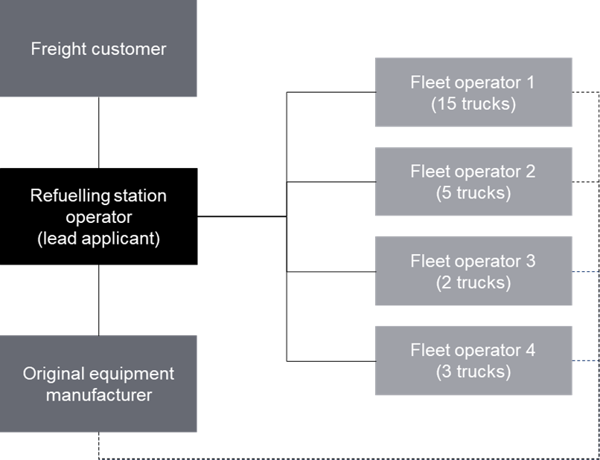
Who can apply?
The initiative is a competitive grant program open to all market participants
To achieve the initiative’s objectives, applicants are strongly encouraged to apply as a consortium
We anticipate that consortia will need to be comprised of market participants with the necessary capabilities and capacity to meet our objectives and project parameters
Applicants are not required to apply as a consortium
An indicative consortium structure

Slide 15
Eligibility
Eligible applicants must meet the applicant and project eligibility criteria
Applicant eligibility criteria
Applicable to lead applicants and any consortium members
Described in Section 3.2 of the application guidelines
Project eligibility criteria – your project must:
propose a network of 4 or more refuelling stations on or in close proximity to the Hume Highway as defined in Section 9.4 of the application guidelines
propose a fleet of at least 25 hydrogen-powered trucks* that
operate for linehaul transportation
must be heavy vehicles as defined under the National Heavy Vehicle Law with a minimum 4.5 tonnes gross vehicle mass
must be compliant with relevant Australian Design Rules (ADRs)
not have gone ahead in the near term without the support of our initiative
use renewable hydrogen as defined in Section 9.3
*We reserve the right to accept non-conforming applications with respect to the number of hydrogen-powered trucks, however, this reduced number may impact merit scoring

Slide 16
What will be funded?
NSW Office of Energy and Climate Change within NSW Treasury (OECC)
Victorian Department of Environment, Land, Water and Planning (DELWP)
OFFICIAL-Sensitive

Slide 17
What will be funded?
The initiative is seeking to support:
The successfully funded project must meet the project parameters
Grant funding can only be used to support eligible expenditure
At least
4
hydrogen refuelling stations
At least
25
hydrogen-powered
linehaul trucks
Section 4.1 of the application guidelines
Section 12.1 of the application guidelines

Slide 18
Project parameters
Hydrogen refuelling stations
Hydrogen- powered trucks
Refuelling capacity
Section 4.1 of the application guidelines
Hydrogen supply
Scalability
Future-proofing
Timing
Funding

Slide 19
What will not be funded?
Ineligible project expenditure*
Onsite renewable hydrogen generation equipment
Hydrogen-powered vehicles operating back-to-base routes around refuelling stations
Equipment already purchased with supplementary funds from another source
Applicant’s parallel future-proofing plans for technology (such as electric vehicle fast-chargers, and infrastructure upgrades such as additional carparking or improvements to customer facilities at refuelling stations)
General operations and administration of the recipient entity that the recipient could reasonably be expected to undertake in the normal course of business
The acquisition of land for a project
Salaries and staffing expenses
Activities that directly relate to NSW and Victorian Government planning assessment processes
*Including but not limited to

Slide 20
Supplementary funding
If you want any supplementary funding of your project to be considered in our assessment process you will need to:
apply to the other government entity prior to close of our initiative’s application period; and
consent to the application and associated information being shared with the other government entity.
Full details on supplementary funding are provided in Section 4.2 of the guidelines.
Note: approval of supplementary funding by another government entity will not result in automatic approval for grant funding under this initiative

Slide 21
The application and assessment process
Ting Yuan, Senior Program Manager Technology Development, DELWP
NSW Office of Energy and Climate Change within NSW Treasury (OECC)
Victorian Department of Environment, Land, Water and Planning (DELWP)
OFFICIAL-Sensitive

Slide 22
Single stage application and assessment process
Review applications for completeness
Merit assessment against the merit criteria
(Section 7)
NSW/Victorian Government approval of applicant identified as the highest merit eligible application
Applicant and project eligibility criteria check
Letter of offer to execute a funding agreement with the Governments
(Targeting February 2023)
Applications close
28 October 2022
Ineligible projects not assessed

Slide 23
Application checklist
Applicants must:
3. address applicant and project eligibility requirements outlined in Section 3.2 and 3.3
4. respond to all merit criteria outlined in Section 7
5. provide all application information requirements outlined in Section 12.2
1. read and review the application guidelines and frequently asked questions (FAQs)
2. read and review the funding agreement conditions that will apply in the event that you are successful*
6. if required, seek clarifications from the Governments via email or through a 1-to-1 meeting as per Section 11.2
7. complete your application through the online application portal on the DELWP Grants website
* Applicants are expected to accept the conditions of this funding agreement template with no or very limited changes.
At our sole discretion, we reserve the right to accept or decline any departures from the funding agreement proposed by applicants.

Slide 24
Merit assessment criteria
NSW Office of Energy and Climate Change within NSW Treasury (OECC)
Victorian Department of Environment, Land, Water and Planning (DELWP)
OFFICIAL-Sensitive

Slide 25
Merit criteria
Criterion 1 (45%)
Contribution to the initiative’s objectives
Alignment to the initiative’s objectives and project parameters
Value for money with respect to grant funding request
Criterion 2 (35%)
Consortium delivery model, capability and capacity
Consortium delivery model
Level of experience and expertise
Criterion 3 (10%)
Application and project plan
Approach to identifying, managing and reporting the project’s activities and risks
Criterion 4 (10%)
Contribution to accelerating the renewable hydrogen industry
Local content, suppliers, regional benefits and jobs
Potential to drive scale and reduce hydrogen refuelling costs
Forecast level of emissions abatement
Financial capacity to deliver the project
Securing social licence and building acceptance of hydrogen industries
Collate and disseminate project knowledge and learnings

Slide 26
How to apply?
NSW Office of Energy and Climate Change within NSW Treasury (OECC)
Victorian Department of Environment, Land, Water and Planning (DELWP)
OFFICIAL-Sensitive

Slide 27
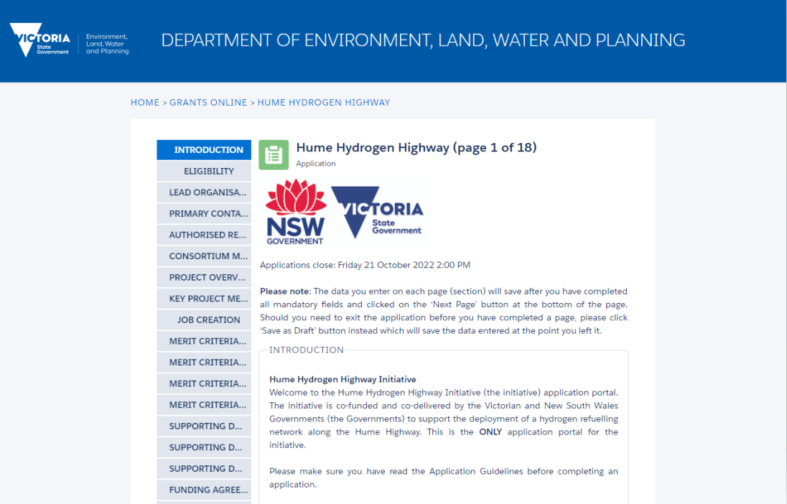
Application Portal

Slide 28
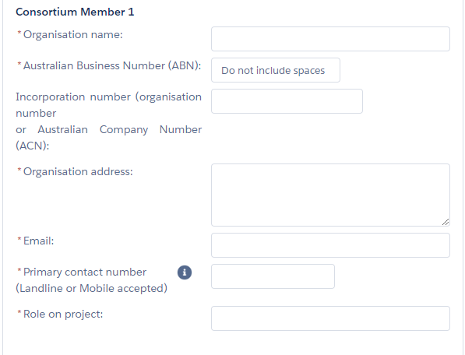
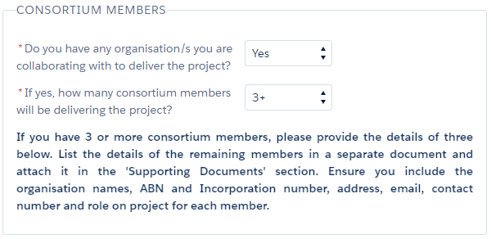
Application Portal – Consortium Members

Slide 29
Application Portal – Site Location

Slide 30
Application Portal – Project Costs

Slide 31
Application Portal – Key Project Metrics

Slide 32
Application Portal – Merit Criteria

Slide 33
Application Portal – Supporting Documentation

Slide 34
Initiative timeline
Event | Date
Applications open | 18 July 2022
Questions close | 21 October 2022 (7 calendar days before applications close)
Applications close | 2pm 28 October 2022
Assessment of applications | November 2022 to December 2022
Approval of grant award | January 2023 to February 2023
Successful applicant notified | February 2023
Finalise funding agreement | March to April 2023
Completion of Hume Hydrogen Highway | 30 June 2025

Slide 35
Contact
If you have any questions, please direct your questions to either:
hydrogen@planning.nsw.gov.au for question regarding the initiative, the application guidelines or the assessment process
grantsinfo@delwp.vic.gov.au for question regarding the online application portal or any difficulties with submission
At our sole discretion and in accordance with probity procedures, we may choose to make questions and clarifications available to all applicants. This process will not release any Commercial-in-Confidence Information. Information provided in response to any question raised by a potential applicant may be uploaded onto the “frequently asked questions” webpage
Initiative website: www.energy.vic.gov.au/grants/hume-hydrogen-highway
NSW Government hydrogen webpage: www.energy.nsw.gov.au/hydrogen
Victorian Government hydrogen webpage: www.energy.vic.gov.au/renewable-hydrogen

Slide 36
Australian Renewable Energy Agency (ARENA)
Alexandra McIntosh - Director | Business Development & Transactions
NSW Office of Energy and Climate Change within NSW Treasury (OECC)
Victorian Department of Environment, Land, Water and Planning (DELWP)
OFFICIAL-Sensitive

Slide 37
Hydrogen Transport
Alex McIntosh Director, Business Development and Transactions
ARENA

Slide 38
Our Focus
Reduce the cost of hydrogen produced from renewable energy
Research and development to demonstrate technologies that address technical challenges along the rest of the hydrogen value chain
Prove the technical feasibility and commercial viability of hydrogen use cases

Slide 39
ARENA’s hydrogen transport portfolio to date
Toyota
BOC
Ark Energy
Viva Energy

Slide 40
Current Programs
ARENA currently funds hydrogen transport projects through the following programs:
Advancing Renewables Program (ARP)
Ongoing and open program
Provide funding to projects under ARENA’s strategic priorities
Future Fuels Funding Program
$127.9 million to support the uptake of zero emissions transport in fleets
Focus Area 3: supporting the deployment of hydrogen fuel cell vehicles and associated hydrogen infrastructure

Slide 41
Further information
hydrogen@arena.gov.au

Slide 42
Clean Energy Finance Corporation (CEFC)
Rupert Maloney – Head of Hydrogen
NSW Office of Energy and Climate Change within NSW Treasury (OECC)
Victorian Department of Environment, Land, Water and Planning (DELWP)
OFFICIAL-Sensitive

Slide 43
CEFC’s Advancing Hydrogen Fund
Investing to lead the market
The CEFC Advancing Hydrogen Fund is aiming to invest up to $300 million of concessional finance to support the growth of a clean, innovative, safe and competitive Australian hydrogen industry.
The CEFC’s debt or equity finance will focus on projects that align with the National Hydrogen Strategy, including projects which have State or Territory Government financial support.
Eligible Projects
Advancing hydrogen production
Developing export and domestic hydrogen supply chains, including hydrogen export industry infrastructure
Establishing hydrogen hubs
Other projects that assist in building domestic demand for hydrogen
As with all CEFC investments, projects must be commercial, and achieve an adequate risk-adjusted return
43

Slide 44
Question and Answer session
NSW Office of Energy and Climate Change within NSW Treasury (OECC)
Victorian Department of Environment, Land, Water and Planning (DELWP)
OFFICIAL-Sensitive

Slide 45
Contact
If you have any questions, please direct your questions to either:
hydrogen@planning.nsw.gov.au for question regarding the initiative, the application guidelines or the assessment process
grantsinfo@delwp.vic.gov.au for question regarding the online application portal or any difficulties with submission
At our sole discretion and in accordance with probity procedures, we may choose to make questions and clarifications available to all applicants. This process will not release any Commercial-in-Confidence Information. Information provided in response to any question raised by a potential applicant may be uploaded onto the “frequently asked questions” webpage
Initiative website: www.energy.vic.gov.au/grants/hume-hydrogen-highway
NSW Government hydrogen webpage: www.energy.nsw.gov.au/hydrogen
Victorian Government hydrogen webpage: www.energy.vic.gov.au/renewable-hydrogen

